Slide 1
Week 10
CPE 487 Digital System Design
Darian Muresan
dmuresan@stevens.edu
© 2020 Stevens Institute of Technology. All Rights Reserved.

Slide 2
Agenda
A little about myself and my vantage points
A little about yourselves and your projects
Relevant project extensions and Ideas for experimenting with VHDL
2

Slide 3
A Little About Me…My Vantage Points
Electrical and Computer Engineering, Ph.D. – Cornell University
Image and Signal Processing
Computer Vision
Machine and Deep Learning
Mathematics and ECE Undergraduate – University of Washington, Seattle
Large Companies Industry Experience
HP
DARPA
Leidos
SAIC
Executive partner in four startups
Co-Founder of two small software companies
Iconasys.com
DMMD.net
Second semester teaching
3

Slide 4
Please Introduce Yourself
Your name & background?
What program / degree are you pursuing?
What is your final project about?
What would you like to get out of this class?
What are your favorite:
Hobbies / Fun things
What would you love to be doing (working on) in 5 years?
Anything else you want to share about yourself?
4

Slide 5
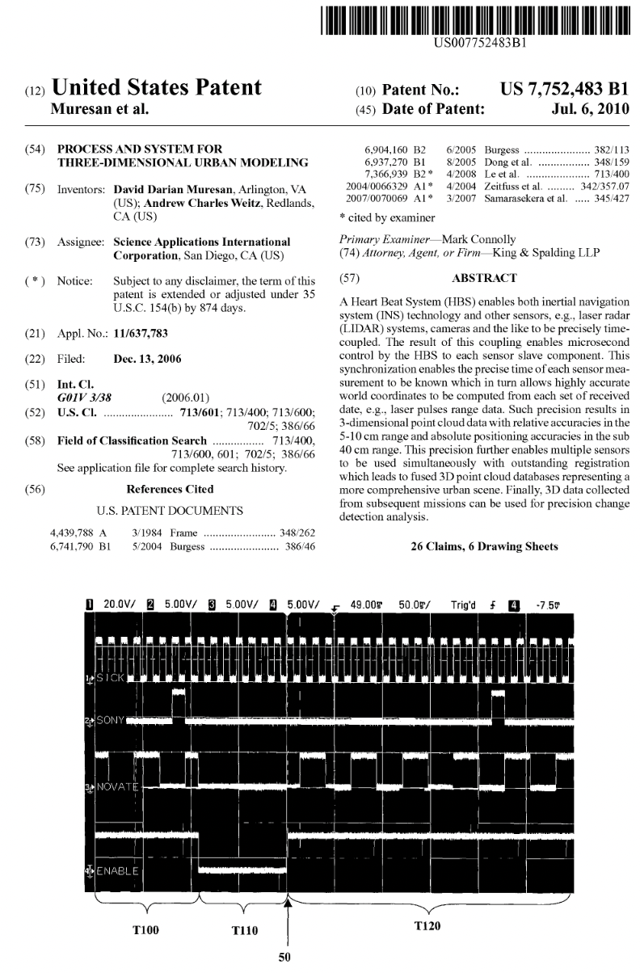
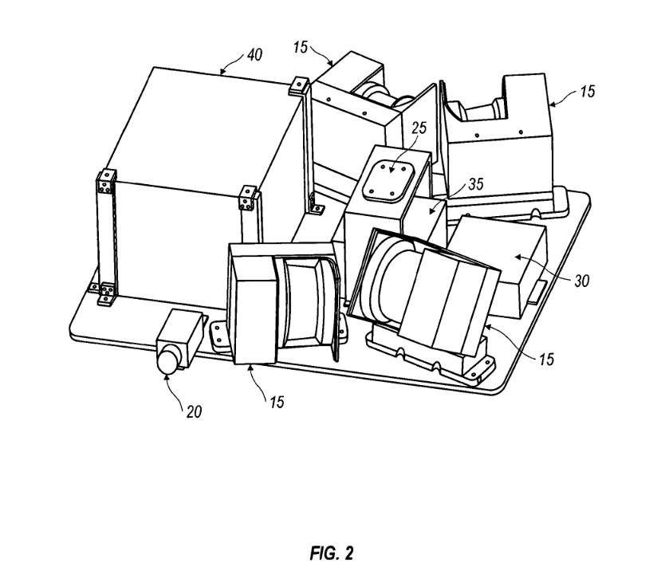
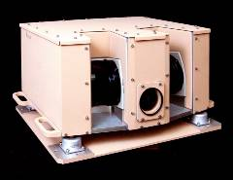
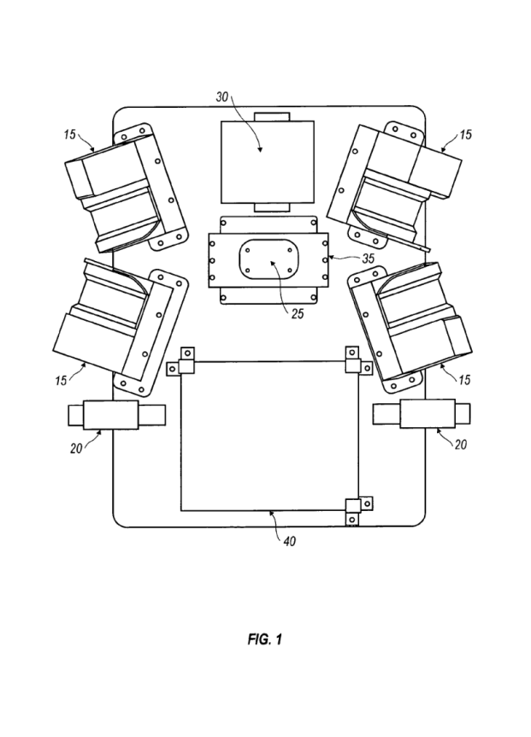
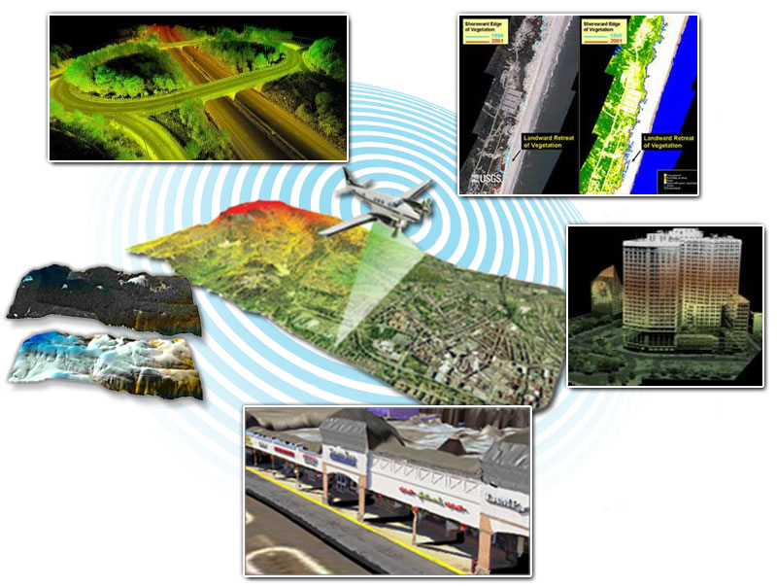
Relevant Hardware Projects : DARPA’s E3D and Urban Scape
© 2020 Stevens Institute of Technology. All Rights Reserved.

Slide 6
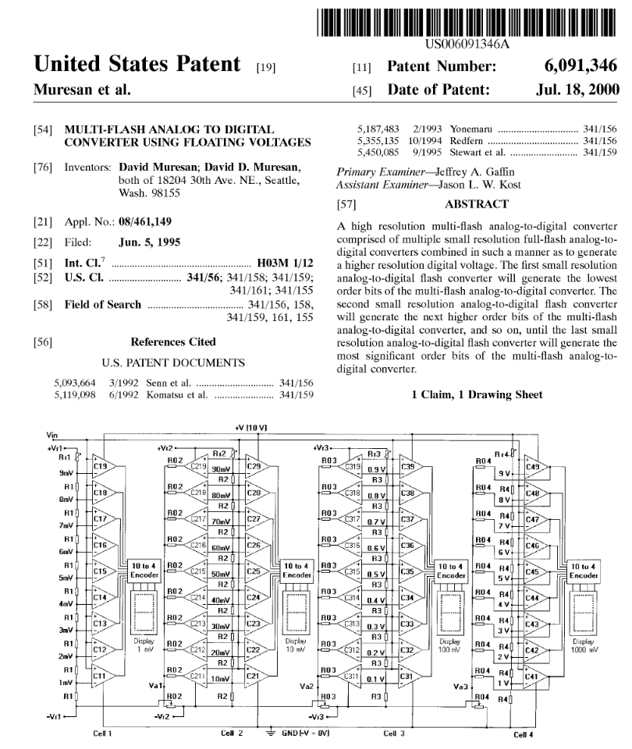
Relevant Hardware Projects : Multi-Flash Analog to Digital Converter
© 2020 Stevens Institute of Technology. All Rights Reserved.

Slide 7
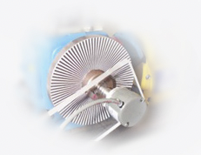
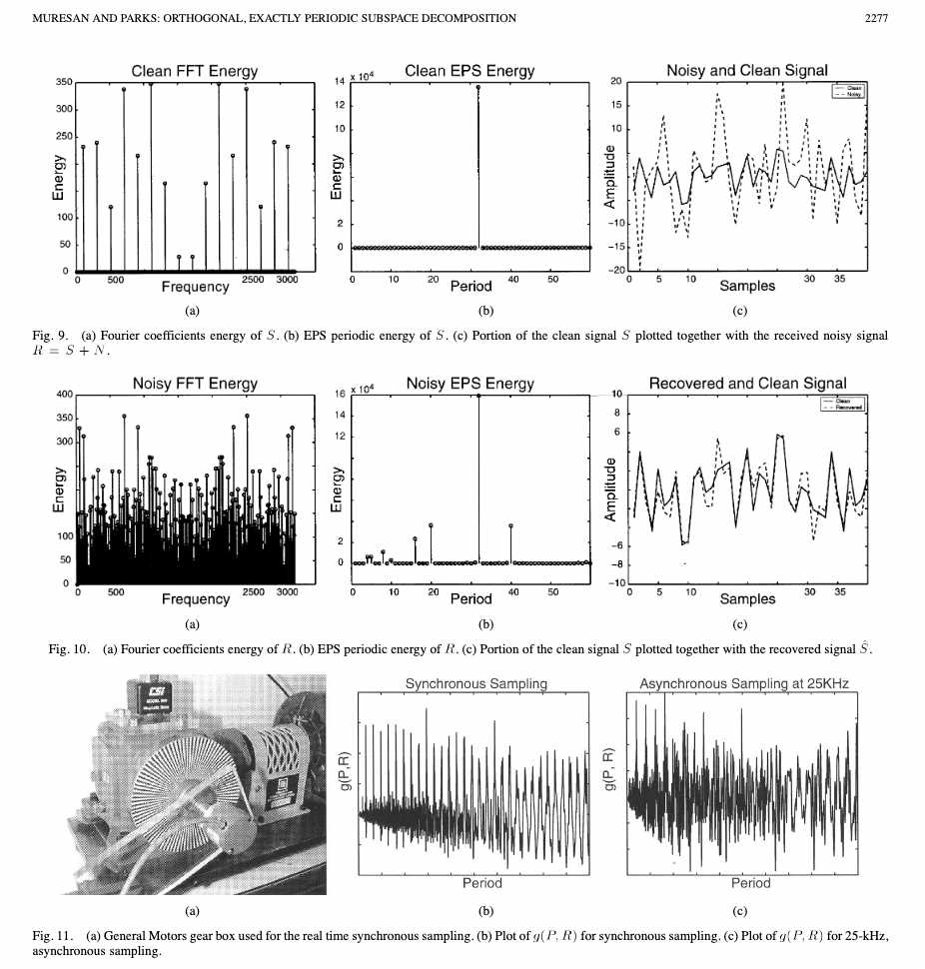
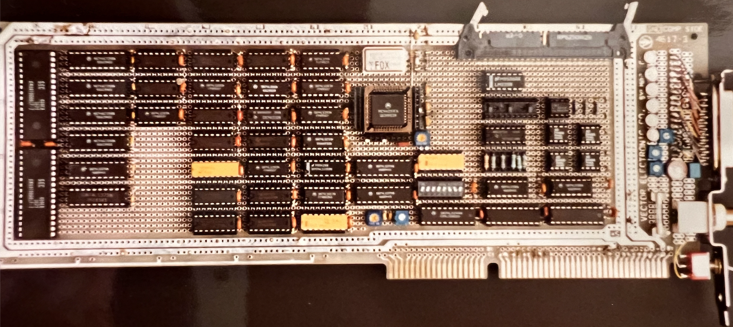
Relevant Projects : PC Oscilloscope and Synchronous Data Acquisition for Period Estimation
© 2020 Stevens Institute of Technology. All Rights Reserved.

Slide 8
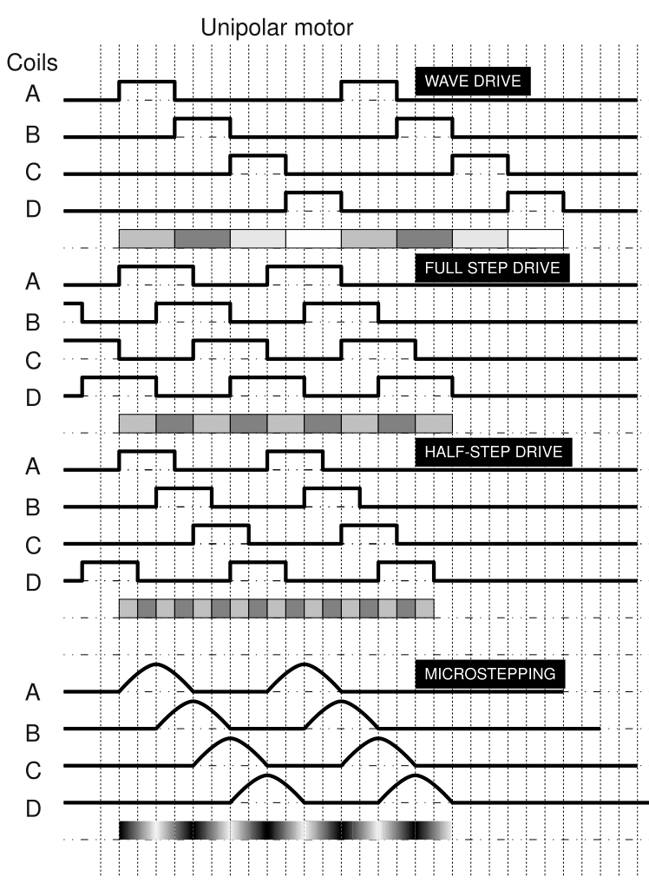
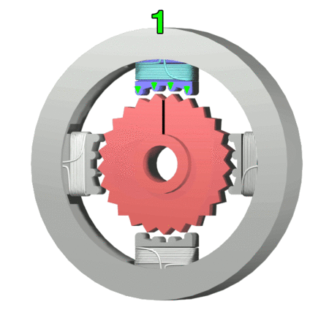
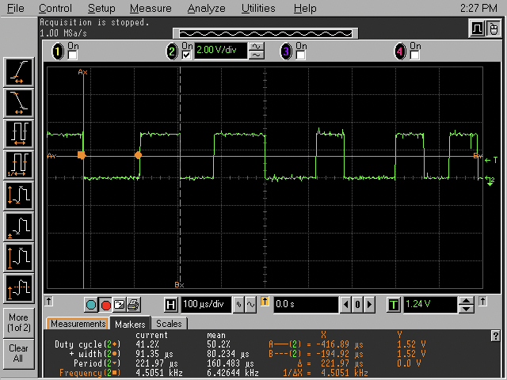
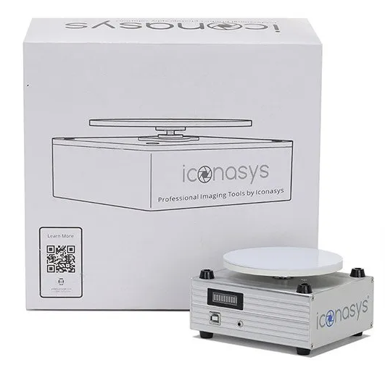
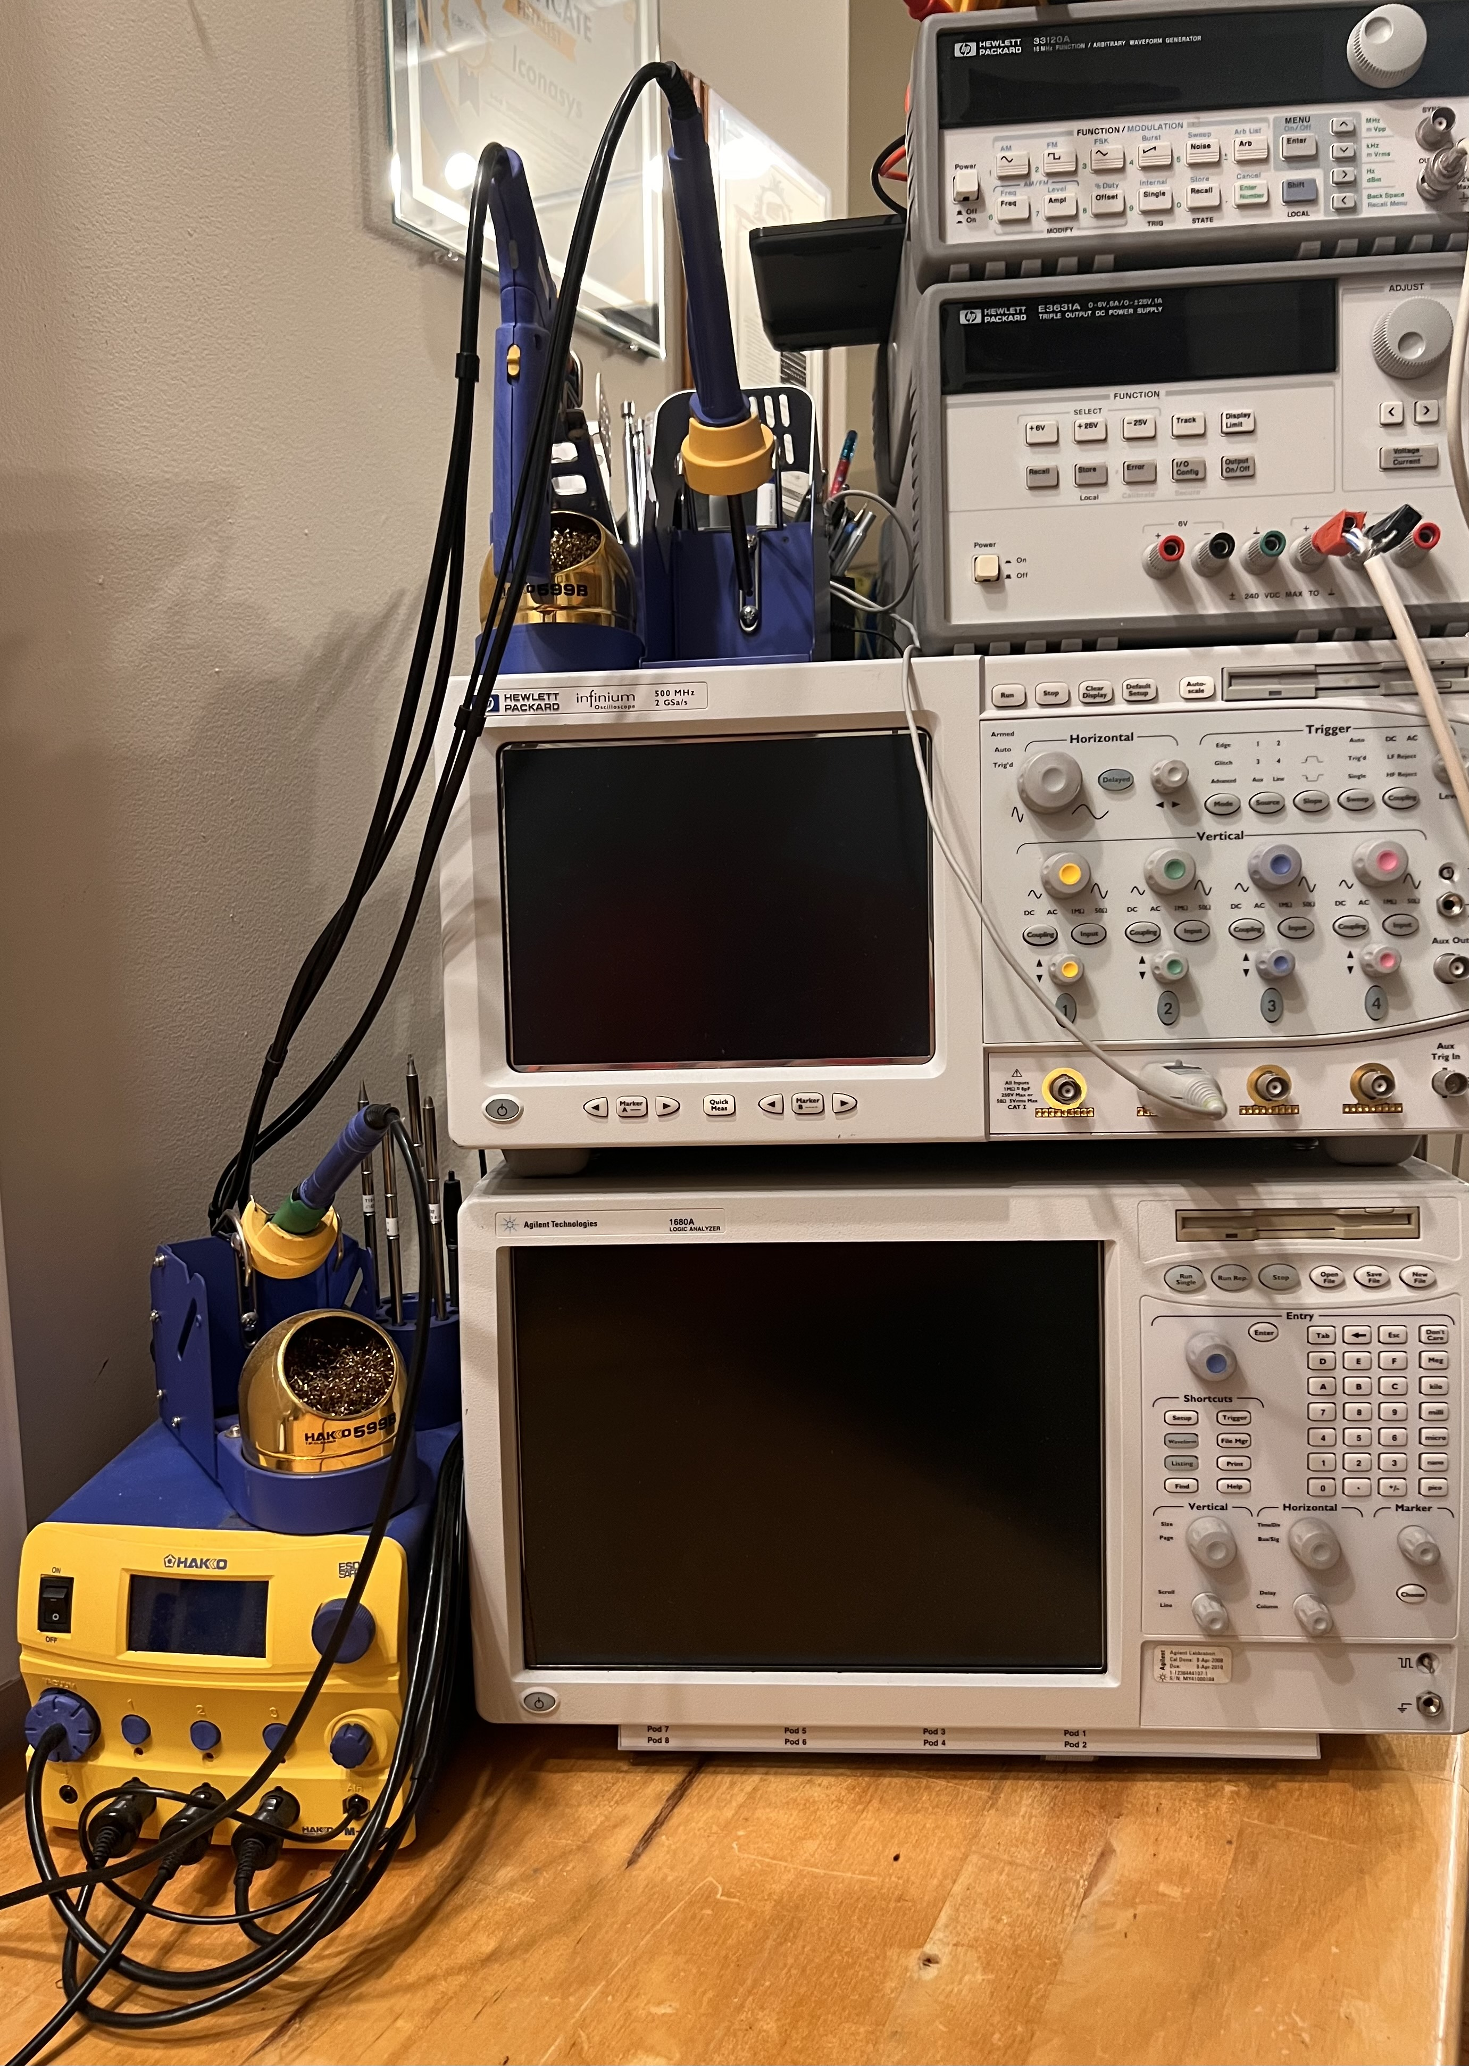
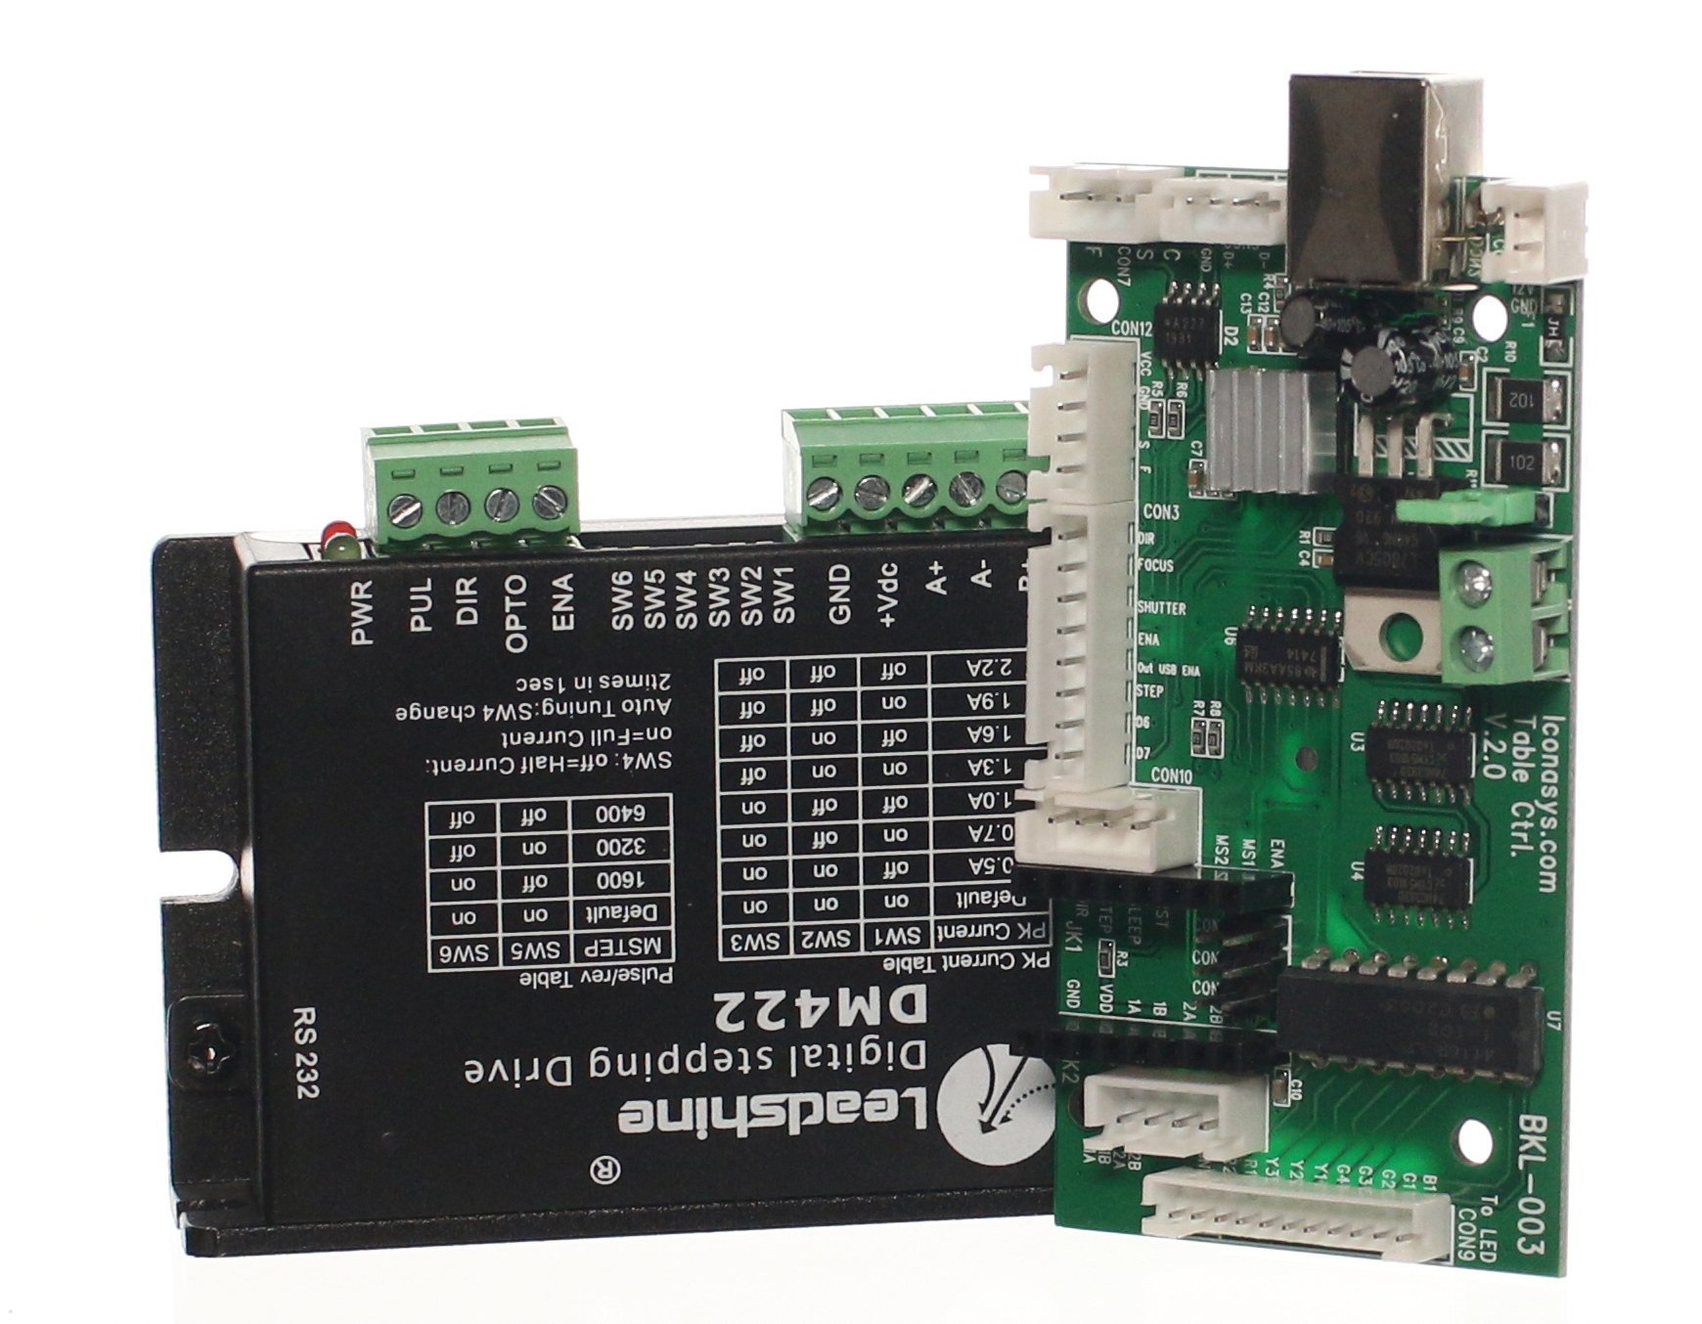
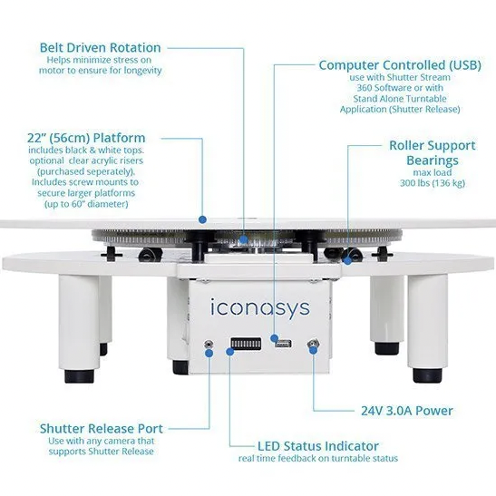
Relevant Projects : Turntable Controller for Product Photography
© 2020 Stevens Institute of Technology. All Rights Reserved.

Slide 9
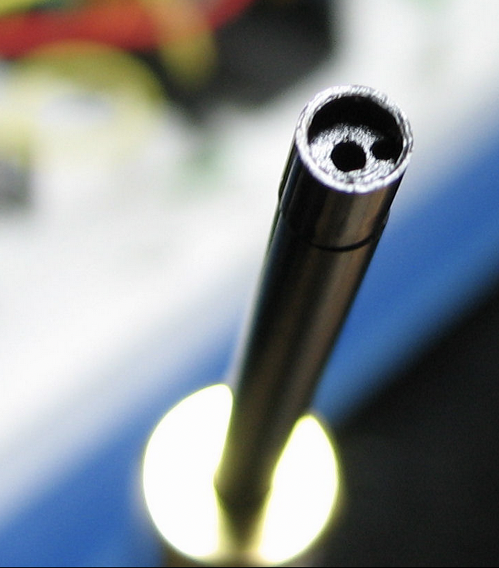
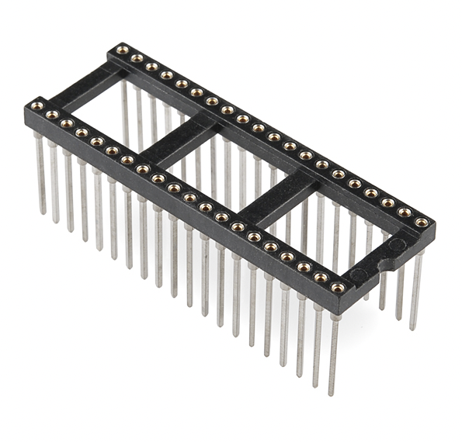
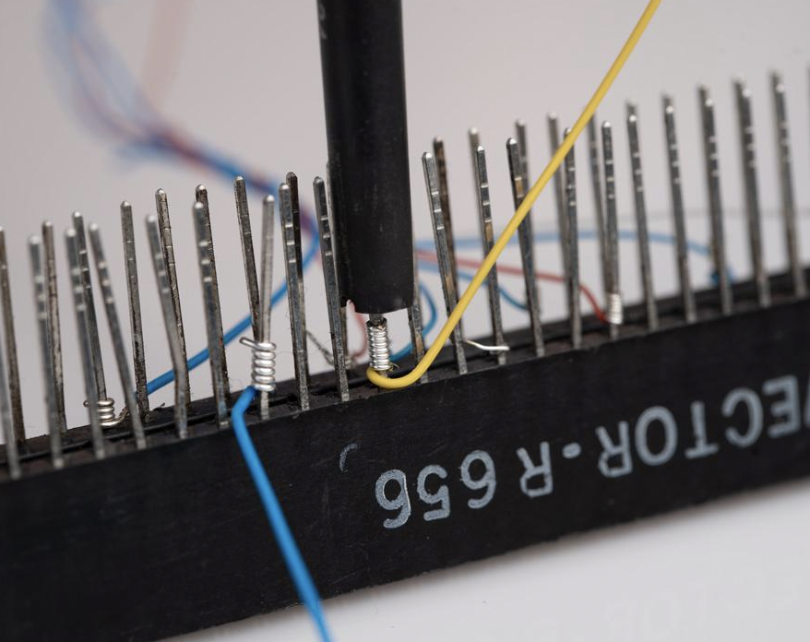
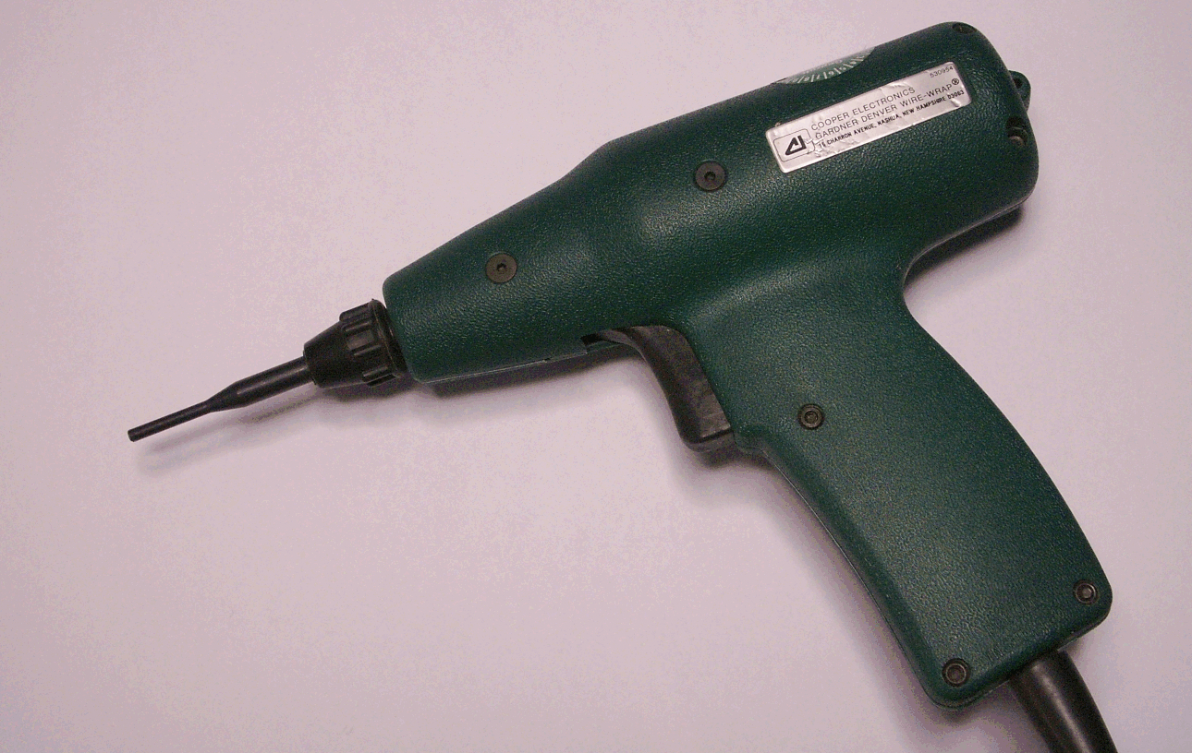
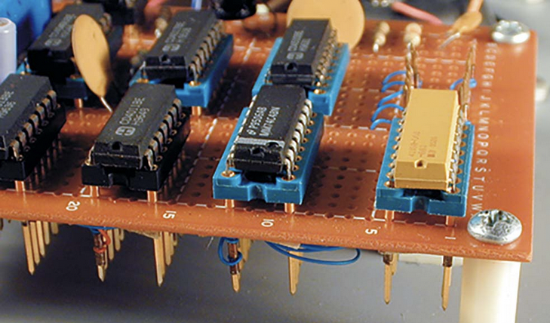
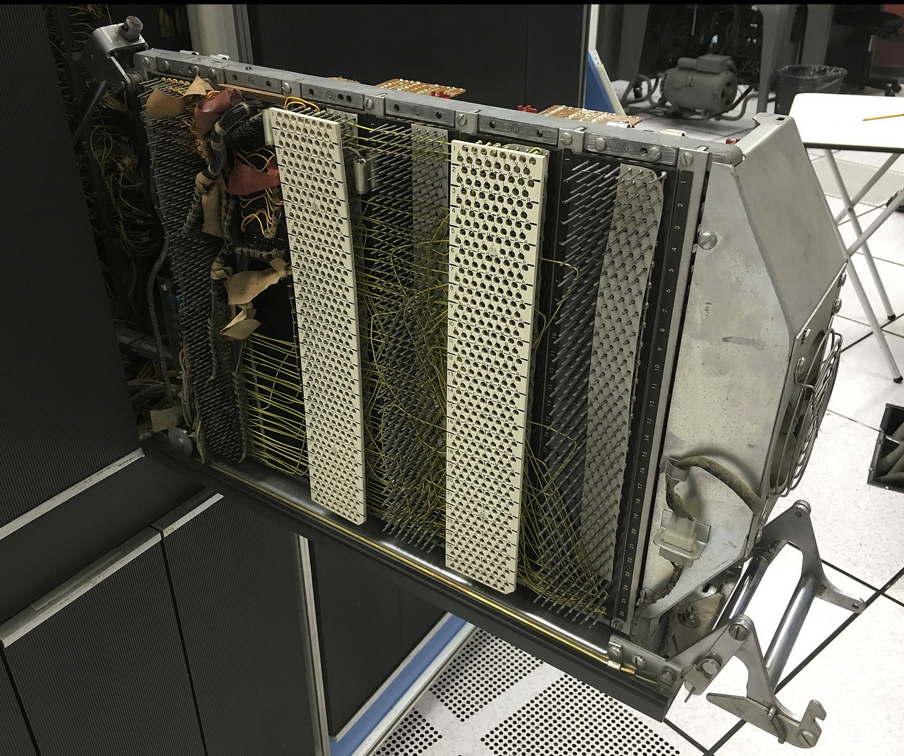
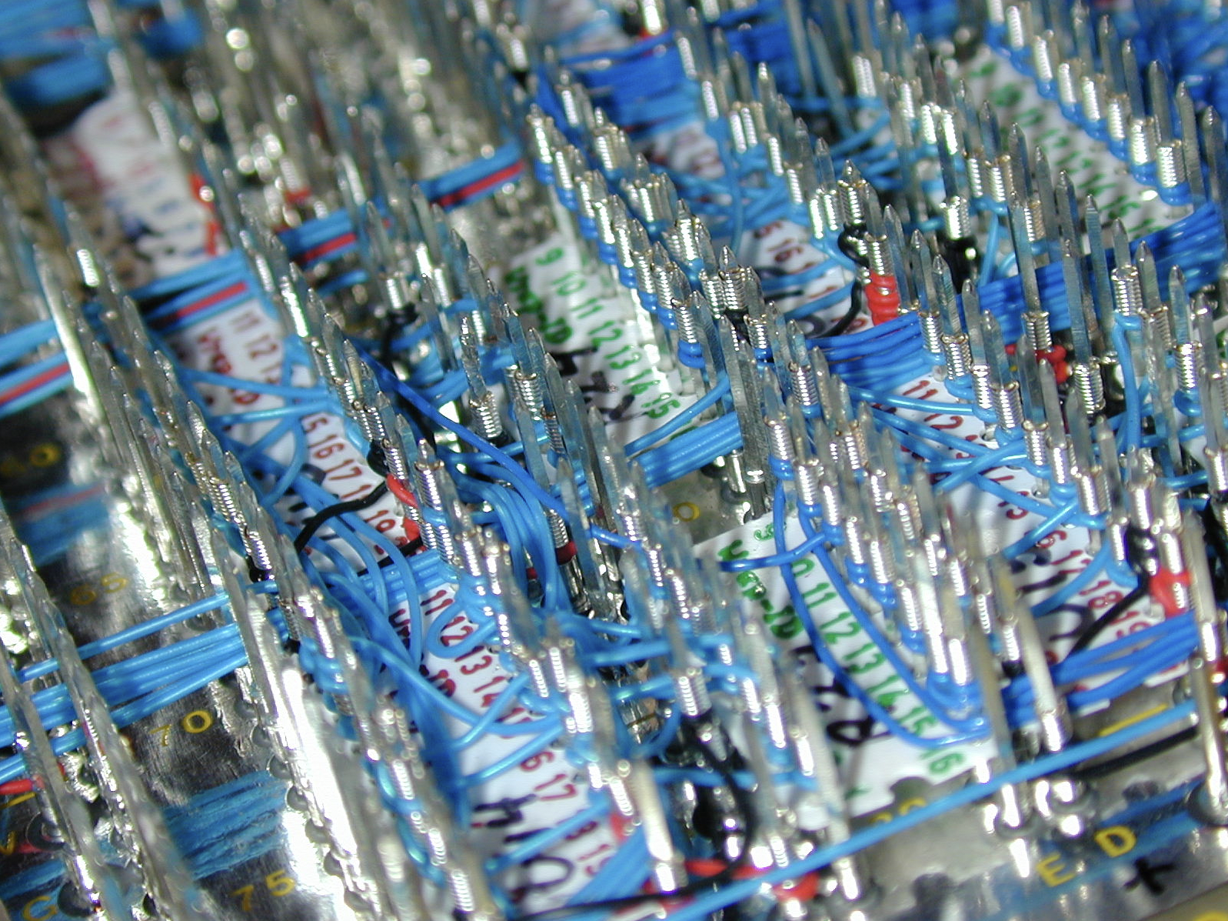
VHDL and Building Your Own Boards
© 2020 Stevens Institute of Technology. All Rights Reserved.

Slide 10
Understanding The Class Progress …
Fan-in
State machines
State machines
High/Low Level In/out Current
A/D & D/A Converterts
D-Flip-Flops
J-K-Flip-Flops
Truth/Function Tables
Open Collector
Karnaugh Maps
Memory Buffers
Mux / De-Mux
Tri-States
Pull-Up / Pull-Down
Counters
Fan-out
© 2020 Stevens Institute of Technology. All Rights Reserved.

